Slide 1
Dynamic Testing Techniques

Slide 2
Dynamic Testing Techniques
Specification Based
Experience Based
Structure Based
1. Equivalence Partitioning
2. Boundary Value Analysis
3. Decision Table Testing
4. State Transition Testing
5. Use Case Testing
Error Guessing
Exploratory Testing
Statement Coverage
Decision Coverage
Condition Coverage
Multiple Condition Coverage

Slide 3
Specification based dynamic testing techniques, also known as testing or functional testing, involve assessing a software application's functionality without knowledge of its internal code structure.
These techniques focus on validating that the software behaves according to its specifications or requirements.
Here are some common specification based dynamic testing techniques
Equivalence Partitioning
Boundary Value Analysis
Decision Table Testing
Use Case Testing
State Transition Testing

Slide 4
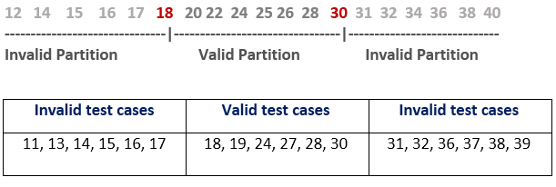
Equivalence Partitioning
Divide the input domain of a system into classes or partitions.
Choose representative test cases from each partition to ensure that the system behaves consistently within each class.
Helps reduce the number of test cases while maintaining test coverage.

Slide 5
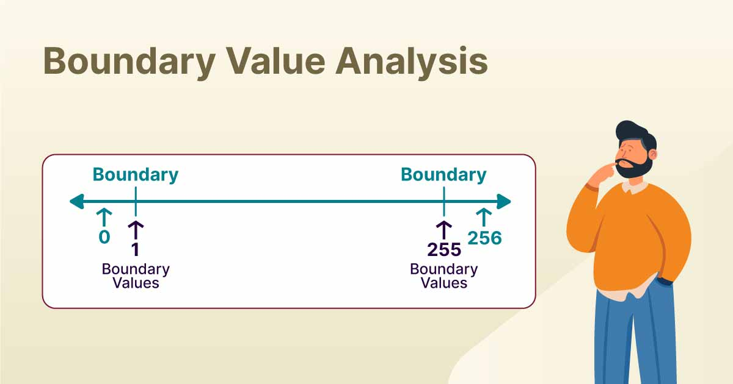
Boundary Value Analysis
Focuses on testing values at the boundaries or edges of input domains.
Examines how the system behaves with values at the lower and upper limits, as well as just beyond those limits.
Helps uncover errors that might occur at the extremes of input values.

Slide 6
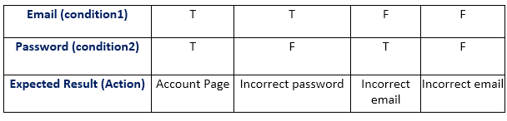
Decision Table Testing
Creates a table that specifies all possible combinations of inputs and corresponding actions or outcomes.
Helps ensure that all possible combinations are tested, making it effective for systems with complex business rules.

Slide 7
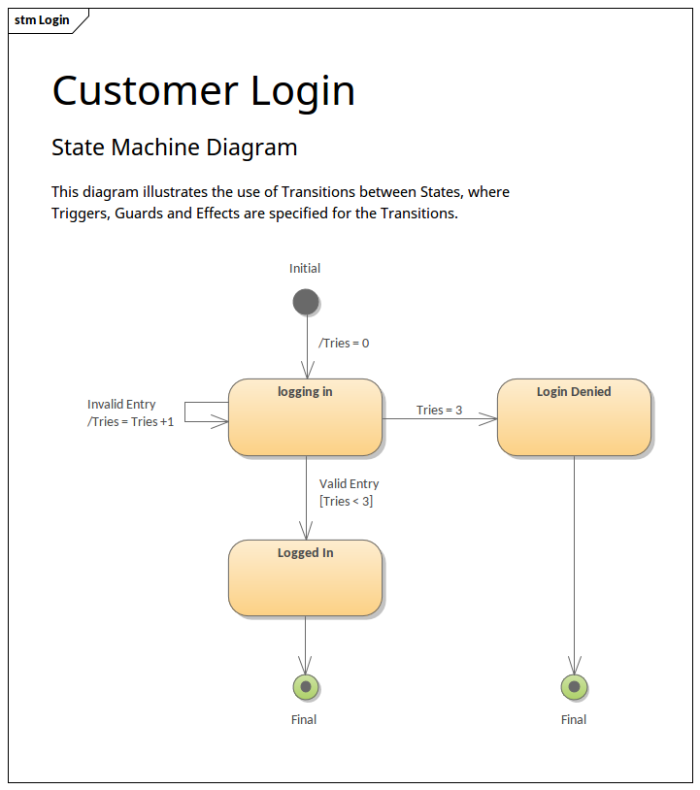
State Transition Testing
Applicable for systems with different states.
Models the system's behavior in response to events and transitions between different states.
Ensures that the system moves correctly between states based on inputs.

Slide 8
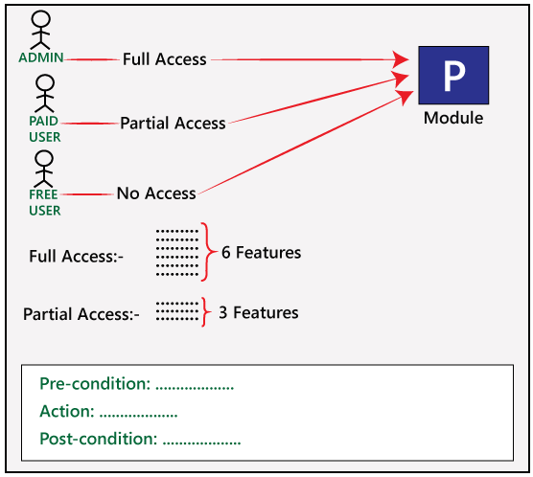
Use Case Testing
Focuses on testing the interactions between the system and its users.
Uses scenarios or use cases derived from requirements to validate the system's functionality.

Slide 9
Error Guessing
Error guessing is an informal and intuitive testing technique where testers use their experience, knowledge, and intuition to identify potential areas of the software that are likely to contain defects.
It is a technique based on the tester's skill, domain expertise, and understanding of common mistakes made during software development.

Slide 10
Error guessing typically works
1. Tester Experience:
Testers rely on their experience and knowledge of common programming errors, system vulnerabilities, and industry best practices.
2. Intuition:
Testers use their intuition to guess where defects might occur based on factors such as complexity, criticality, or areas prone to errors.
3. Exploratory Testing:
Testers explore the application dynamically without relying strictly on predefined test cases.
They try different inputs, use cases, or scenarios that may not have been explicitly documented.
4. Common Mistakes:
Testers focus on areas where developers commonly make mistakes, such as boundary conditions, error handling, or data validation.
5. Risk Analysis:
Testers analyze the software requirements and design to identify potential high risk areas where errors are more likely to occur.

Slide 11
Error guessing typically works
6. Previous Defects:
Testers consider any known defects from previous testing phases and target similar areas for additional testing.
7. Negative Testing:
Testers intentionally provide incorrect or unexpected inputs to see how the system responds to invalid data or user actions.
8. Code Inspection:
Testers may review the code or design documentation to identify potential weaknesses or areas that seem prone to errors.
9. Exploring Complex Features:
Testers concentrate on testing complex features or functionalities that are more likely to harbor defects.
10. Unsupported Configurations:
Testers explore the software's behavior in unsupported configurations or environments, where unexpected issues may arise.

Slide 12
Exploratory Testing
Exploratory testing is a manual software testing technique that involves testers looking for bugs without a script or test cases.
It's often described as a simultaneous process of learning, designing, and executing tests.
Some Characteristics:
It's an agile software testing technique.
It's unscripted and involves minimal planning.
Testers use their creativity and domain knowledge to explore software for defects, vulnerabilities, and usability issues.
It encourages testers to think creatively and simulate real-world usage.
It involves testers examining the system with no pre-established test cases and no previous exposure to the system.
Testers create a test idea to understand what they are looking for and start exploring the software.

Slide 13
Decision coverage
Decision coverage testing is a structural or white-box testing technique that aims to ensure that each decision point in a program's source code is executed at least once during testing.
A decision point, also known as a branch, represents a point in the code where the program can take one of two or more paths based on a condition (e.g., an if statement).
Decision coverage is considered complete when all possible decision outcomes have been covered.
Decision coverage is a metric used to assess the thoroughness of testing with respect to decision points. However, it does not guarantee full path coverage or the testing of all possible combinations of conditions in the code.
Other coverage criteria, such as statement coverage or branch coverage, may need to be considered in conjunction with decision coverage to achieve a more comprehensive testing strategy.
This technique helps in identifying areas of the code where different decision outcomes have not been exercised, allowing testers to create additional test cases to improve coverage and increase the likelihood of detecting defects related to decision logic.

Slide 14
Decision coverage
1. Identify Decision Points:
Review the source code and identify decision points. These are typically associated with if statements, switch statements, or other constructs where the program makes a decision to take one path or another.
2. Create Test Cases:
Develop test cases that specifically target each decision point. For each decision, there are two possible outcomes (true or false), so test cases should be designed to cover both conditions.
3. Execute Test Cases:
Run the test cases and track which decision outcomes are exercised during the testing process.
4. Analyze Coverage:
Determine the percentage of decision points that have been executed by the test cases. This is calculated as the number of decision outcomes covered divided by the total number of decision outcomes in the code.
Decision Coverage = Number of decision outcomes covered\Total number of decision outcomes * 100

Slide 15
Statement coverage
Statement coverage is a white-box testing technique that measures the extent to which each line of code in a program has been executed at least once during testing. The goal is to ensure that every statement in the source code is executed, helping identify areas of the code that have not been tested.
Here's how statement coverage testing works:
1. Identify Statements: Examine the source code and identify individual statements. A statement is a line of code that performs a specific action.
2. Create Test Cases: Develop test cases to exercise different parts of the code. The objective is to ensure that each statement is executed at least once during the testing process.
3. Execute Test Cases: Run the test cases and monitor which statements are executed. The testing tool or coverage analysis tool keeps track of the coverage achieved.
4. Analyze Coverage: Calculate the percentage of executed statements in relation to the total number of statements in the code.
Statement Coverage = Number of executed statements\textTotal number of statements * 100
Statement coverage is considered complete when all statements in the code have been executed.
While statement coverage provides a basic measure of test coverage, it does not guarantee the testing of all possible code paths or conditions. For a more comprehensive assessment, additional coverage criteria such as branch coverage or decision coverage may be used in conjunction with statement coverage.
Statement coverage is a useful metric for identifying dead code (code that is not executed under any circumstances) and ensuring that the code has been at least superficially exercised. However, it's important to note that achieving high statement coverage does not necessarily imply that the code is free of defects; it only indicates which lines of code have been executed during testing.

Slide 16
Condition coverage
Condition coverage, also known as predicate coverage, is a white-box testing technique that aims to ensure that each boolean condition in a program has been evaluated to both true and false during testing.
This level of coverage goes beyond basic statement coverage and provides a more thorough examination of the decision-making aspects of the code.
Here's how condition coverage testing works:
1. Identify Boolean Conditions: Review the source code and identify boolean conditions, typically associated with if statements, while loops, and similar constructs.
2. Create Test Cases: Develop test cases to exercise different conditions in the code. The goal is to ensure that each condition is evaluated to both true and false during the testing process.
3. Execute Test Cases: Run the test cases and monitor which conditions are evaluated to true and which are evaluated to false. The testing tool or coverage analysis tool keeps track of the coverage achieved.
4. Analyze Coverage: Calculate the percentage of conditions that have been evaluated to both true and false in relation to the total number of conditions in the code.
Condition Coverage = (Number of conditions evaluated to true and false\Total number of conditions) * 100
Condition coverage is considered complete when all boolean conditions in the code have been evaluated to both true and false.
Condition coverage is valuable for uncovering potential issues related to decision logic in the code. By ensuring that each condition is exercised in both true and false states, testers can identify situations where certain conditions may not be adequately tested. However, like other coverage metrics, achieving high condition coverage does not guarantee the absence of defects, and additional testing criteria may be necessary for a comprehensive testing strategy.

Slide 17
Multiple condition coverage
Multiple condition coverage, also known as compound condition coverage or MC/DC (Modified Condition/Decision Coverage), is a white-box testing technique that extends condition coverage by ensuring that each combination of conditions within a boolean decision has been evaluated during testing. This level of coverage is particularly valuable in systems with safety-critical requirements, such as those in aerospace or automotive industries.
Here's how multiple condition coverage testing works:
1. Identify Boolean Decisions: Identify decision points in the source code where multiple conditions are combined using logical operators (e.g., AND, OR).
2. Create Test Cases: Develop test cases to cover all possible combinations of conditions within each boolean decision. For each decision, there will be 2^n combinations, where n is the number of conditions in the decision.
3. Execute Test Cases: Run the test cases and ensure that each combination of conditions is exercised. The testing tool or coverage analysis tool keeps track of the coverage achieved.
4. Analyze Coverage: Calculate the percentage of combinations that have been evaluated in relation to the total number of combinations for all boolean decisions.
Multiple Condition Coverage} = (Number of combinations evaluated\Total number of combinations)* 100
Multiple condition coverage is considered complete when all combinations of conditions within boolean decisions have been evaluated.
Achieving multiple condition coverage ensures that every possible combination of conditions within a decision has been tested. This helps identify subtle defects related to the interaction of multiple conditions. The MC/DC technique is often used in safety-critical systems where it's crucial to ensure a high level of confidence in the correctness of decision-making logic.
It's worth noting that achieving 100% multiple condition coverage can be challenging, especially as the number of conditions in a decision increases. In practice, achieving a high percentage of coverage is often considered acceptable, and additional testing techniques may be used in conjunction with MC/DC to provide a more comprehensive assessment of the code.

